Slide 2
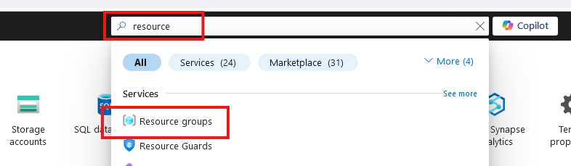
Create Resource Group

Slide 3
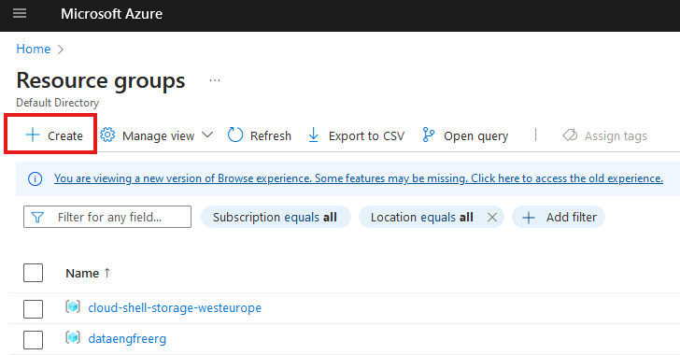
Create Resource Group

Slide 4
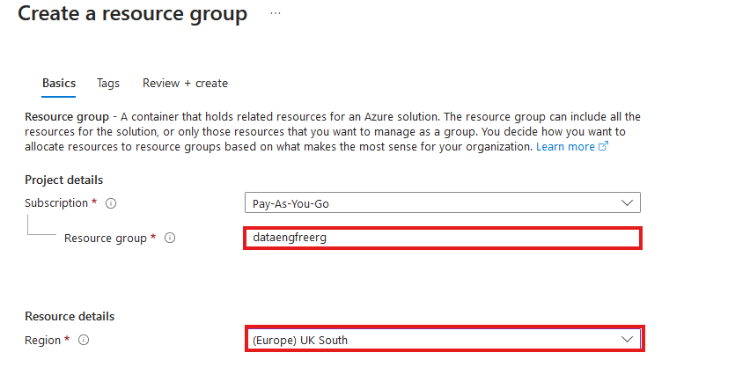
Create Resource Group

Slide 5
VS Code

Slide 6
Azure CLI
Install by following links from: https://learn.microsoft.com/en-us/cli/azure/install-azure-cli
For VSCode:
Azure CLI Tools
Azure Developer CLI
CLI will require extensions for some commands
Automatically downloaded

Slide 7
Create storage account
Create in same region as RG
Primary service is ADLS Gen 2
Primary workload Big Data Analytics
Performance: Standard
Redundancy: LRS
Add container > RAW directory

Slide 8
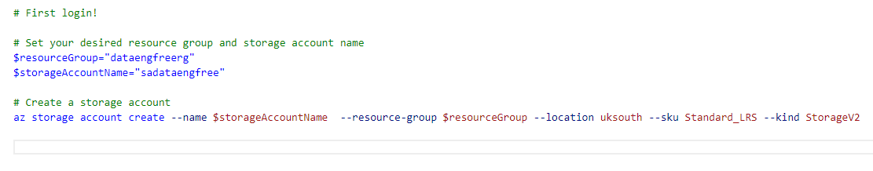
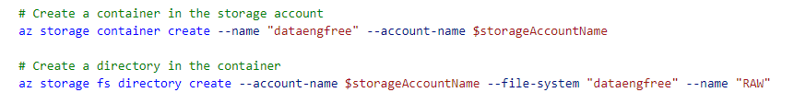
Create storage account

Slide 9
Data & Databases
Concepts to Learn: Data types, databases (SQL and NoSQL), data structures.
Tools/Resources:
Azure SQL Database - free tier available
Cosmos DB: Explore NoSQL databases with a limited free tier on Azure.

Slide 10
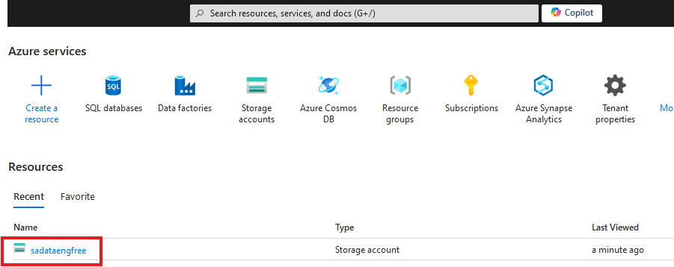

Slide 11
Create Azure Data Factory
Create in same region as RG

Slide 12
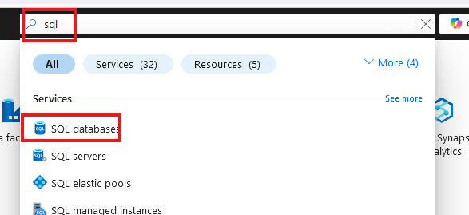
Create SQL database

Slide 13
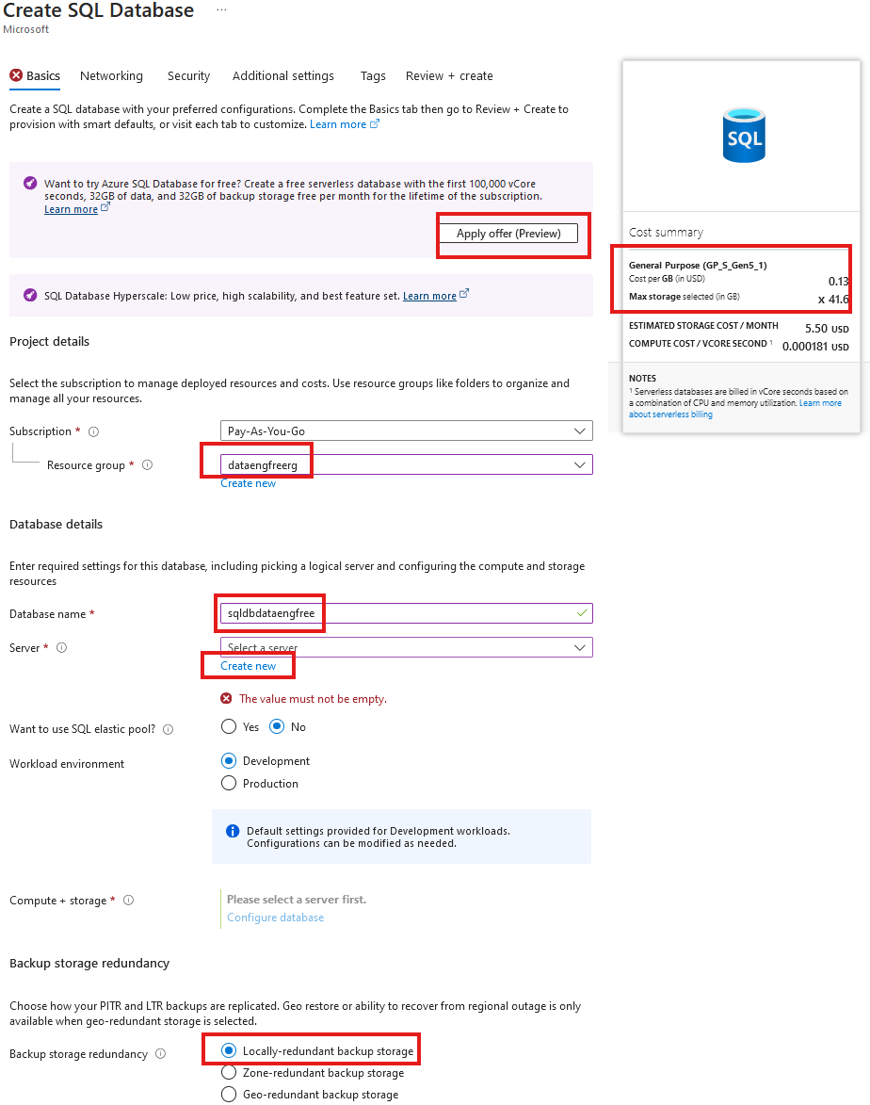
Create SQL database

Slide 14
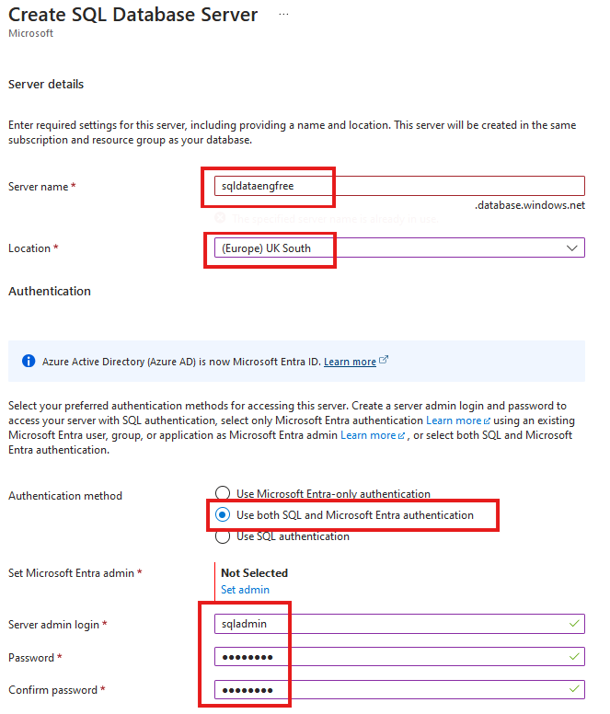
Create SQL database

Slide 15
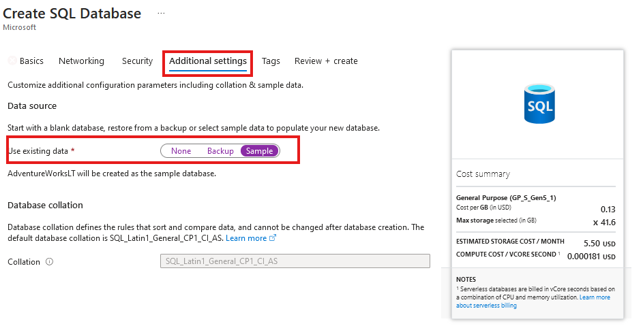
Create SQL database
Add sample data

Slide 16
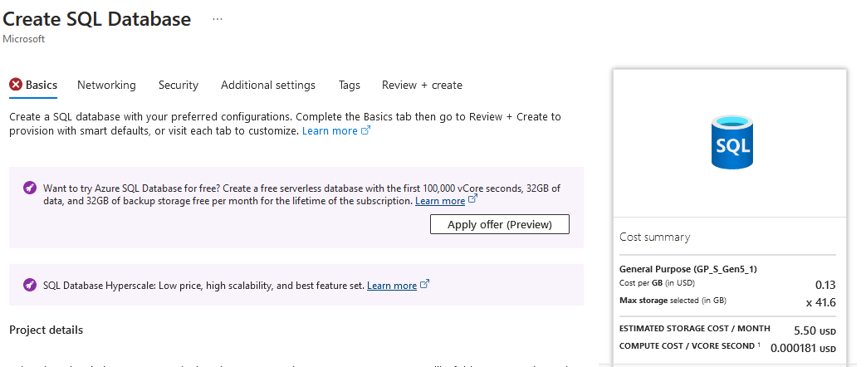

Slide 17
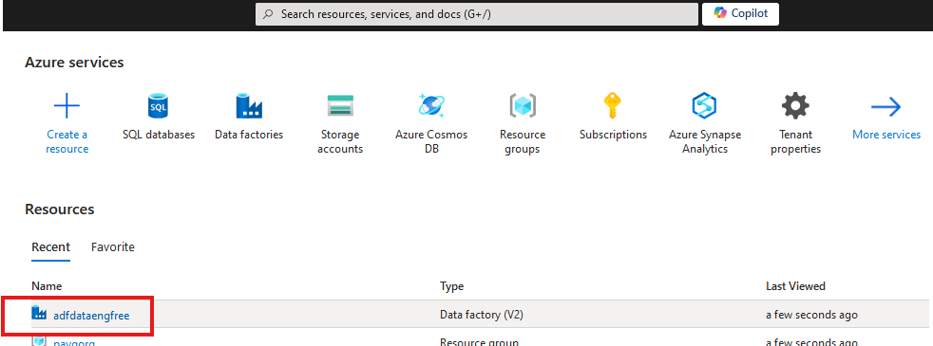
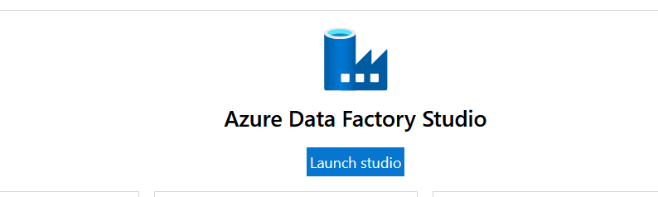

Slide 18
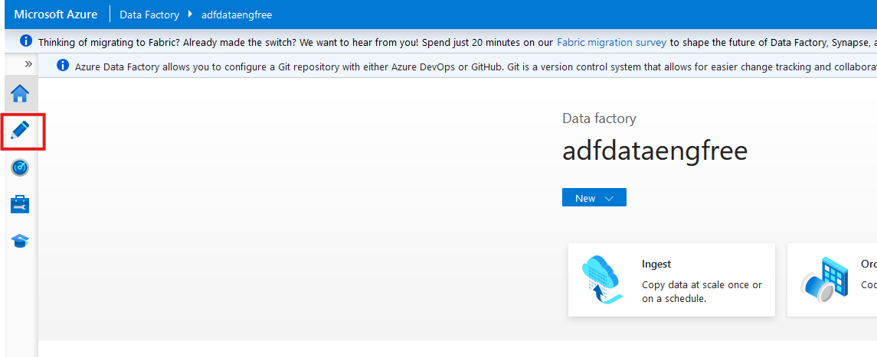

Slide 19
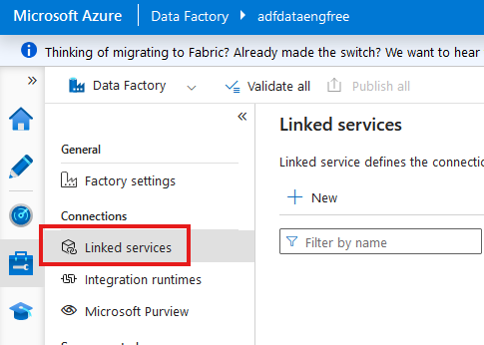

Slide 20
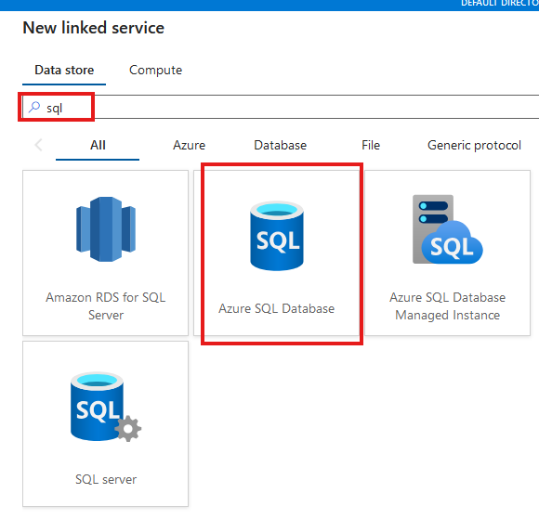

Slide 21
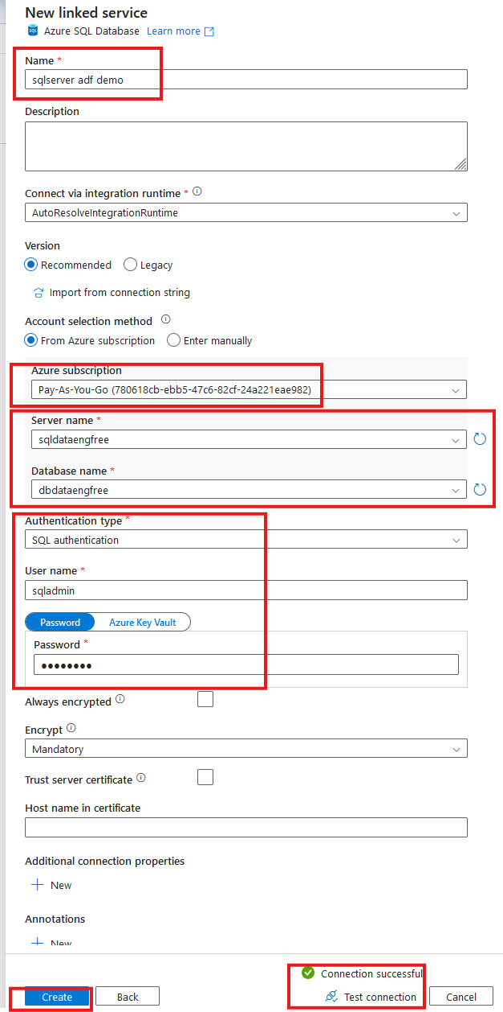

Slide 22
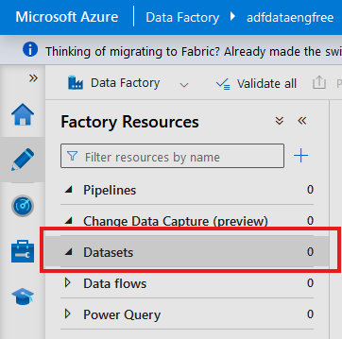
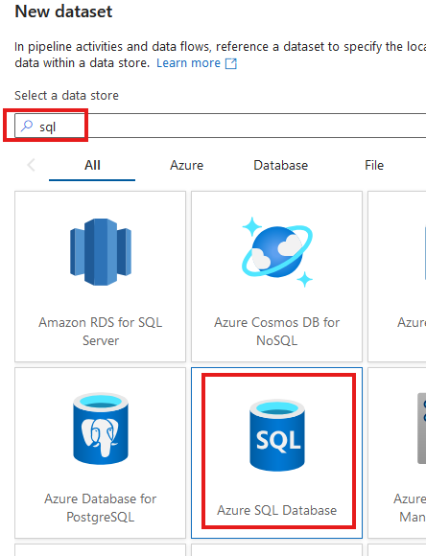

Slide 23
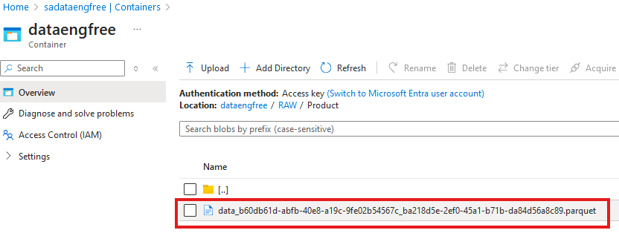

Slide 24
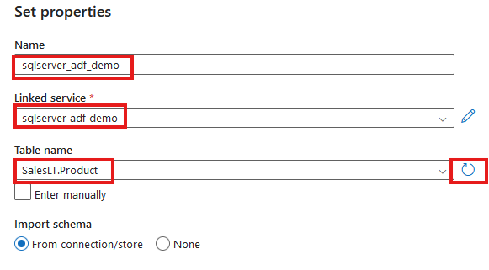

Slide 25
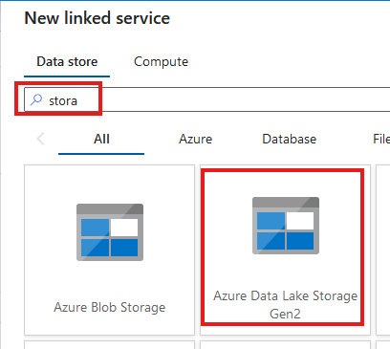
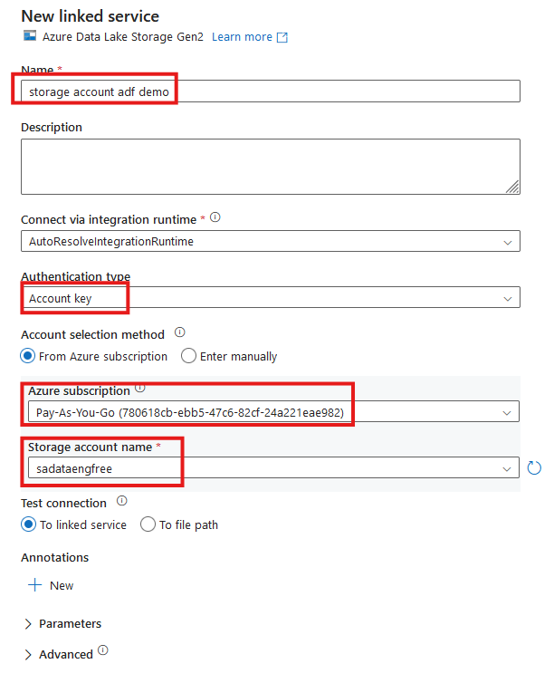


Slide 26
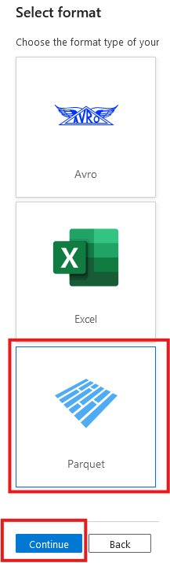
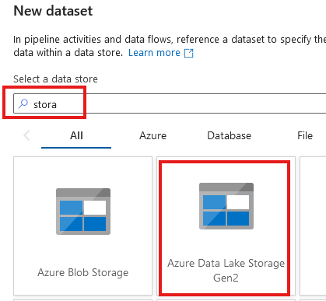

Slide 27
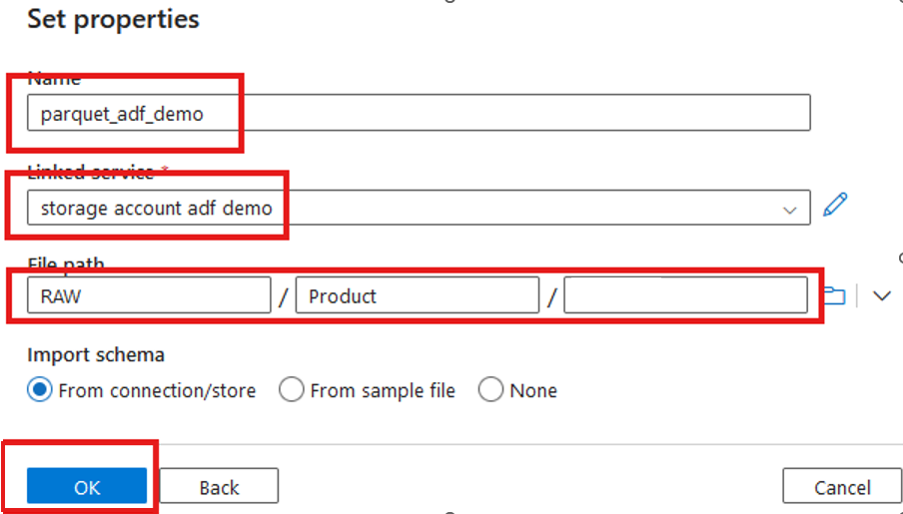

Slide 28
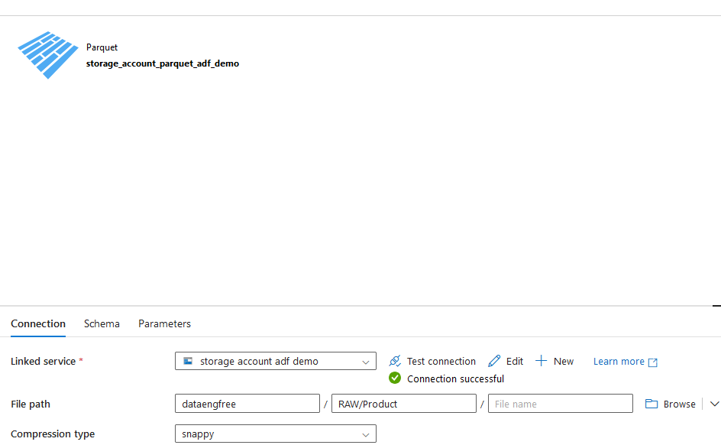

Slide 29
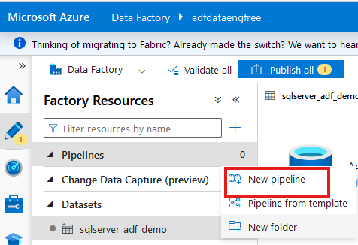
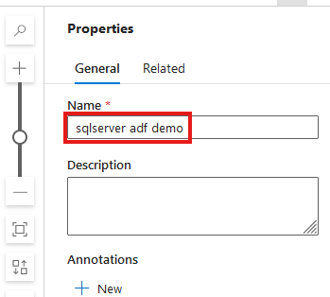

Slide 30
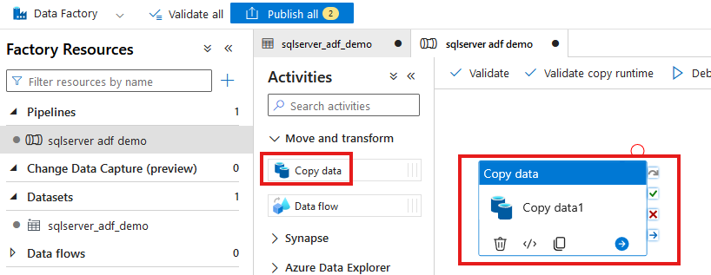

Slide 31
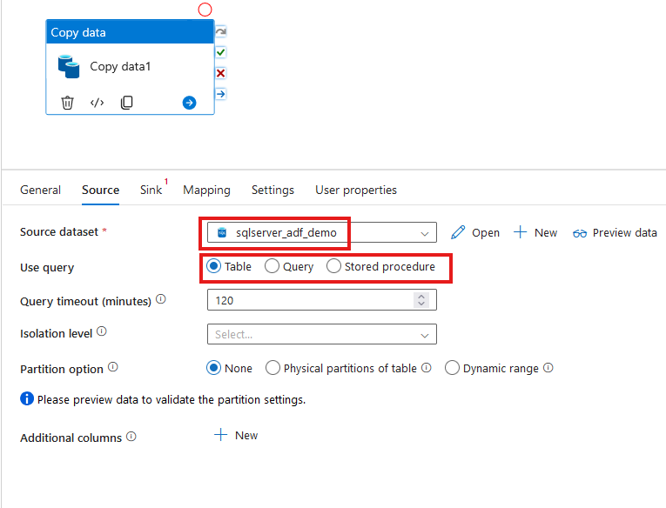

Slide 32
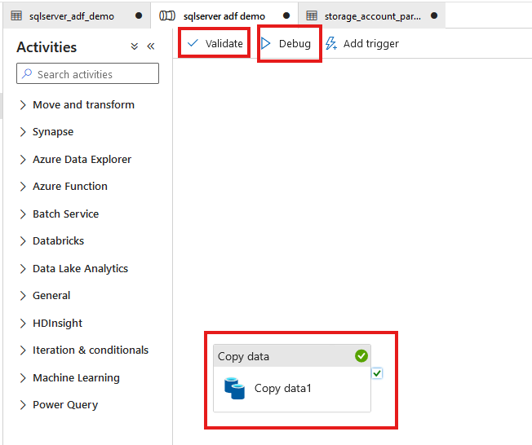

Slide 33
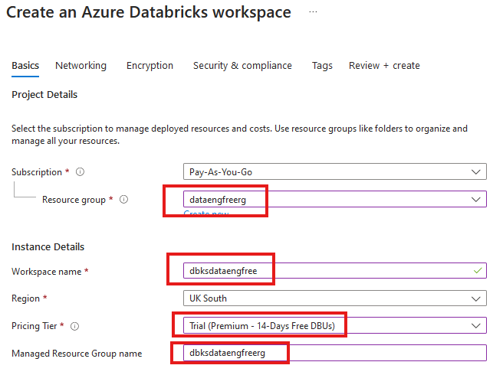


Slide 34
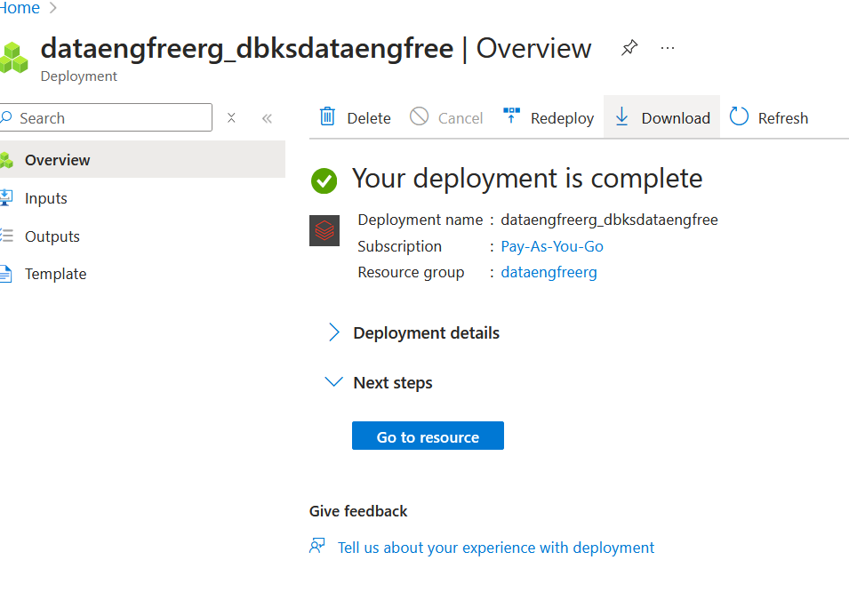

Slide 35
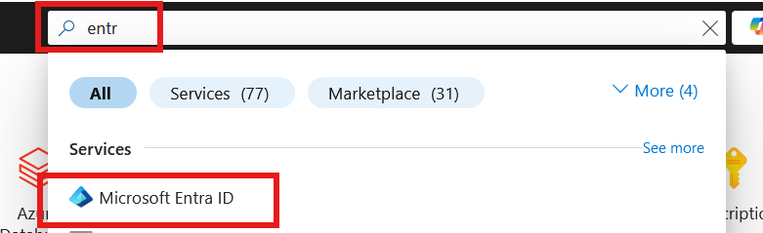
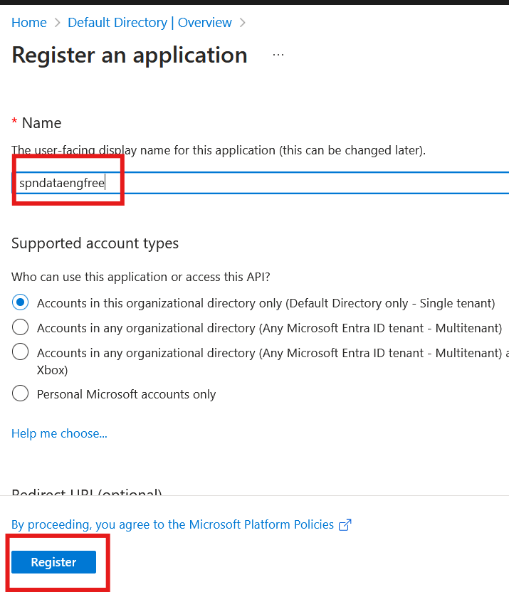

Slide 36
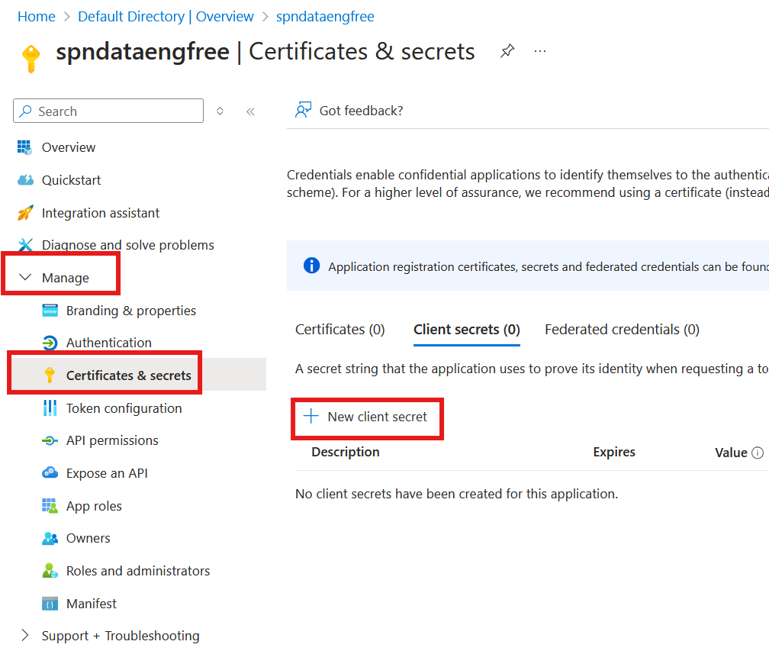
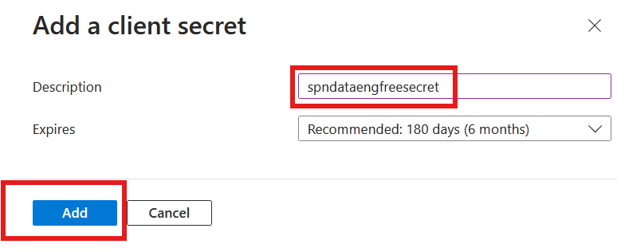

Slide 37
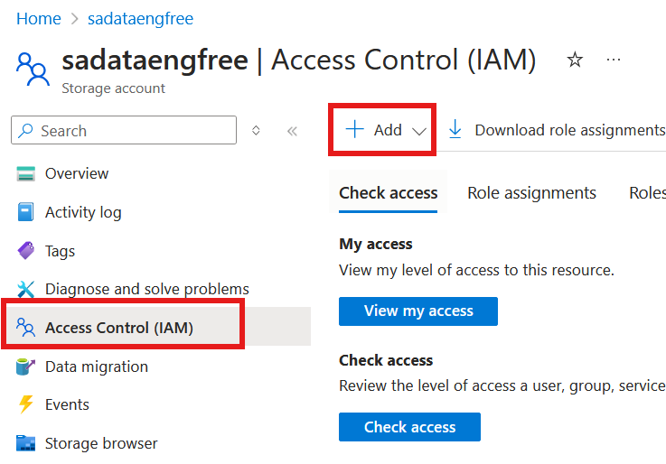
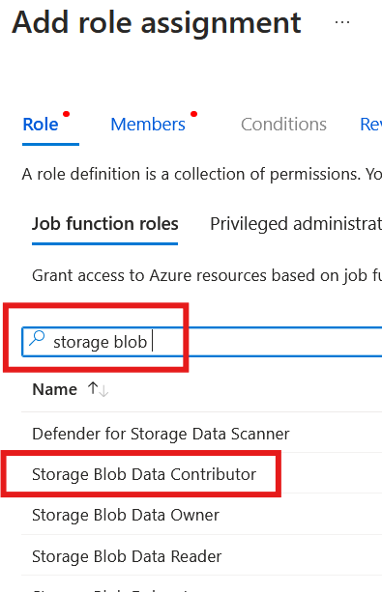

Slide 38
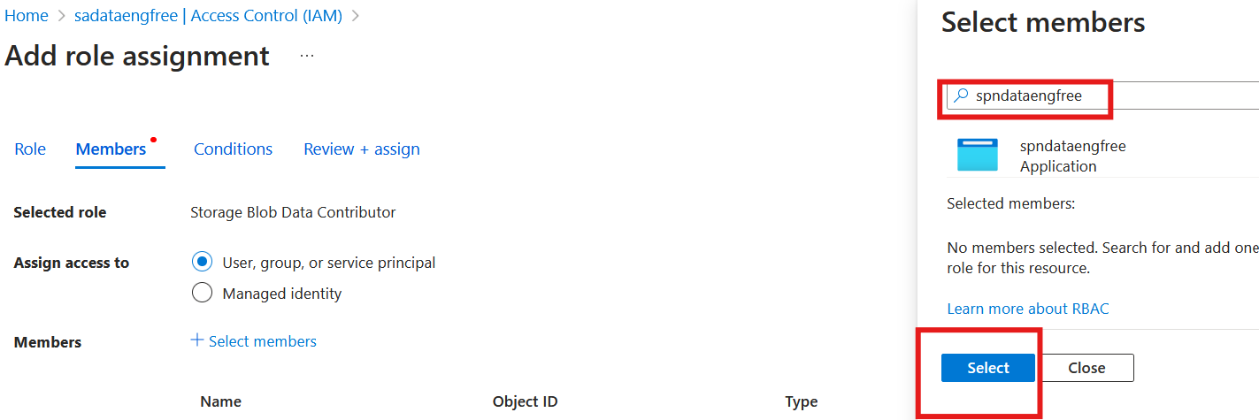

Slide 39
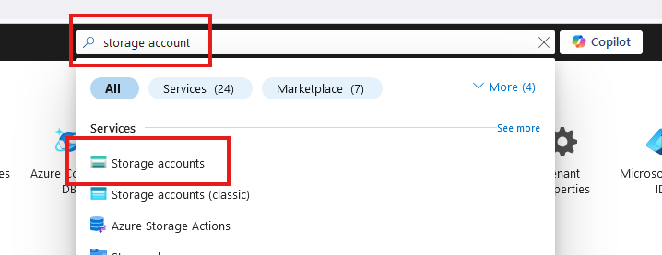
Create storage account

Slide 40
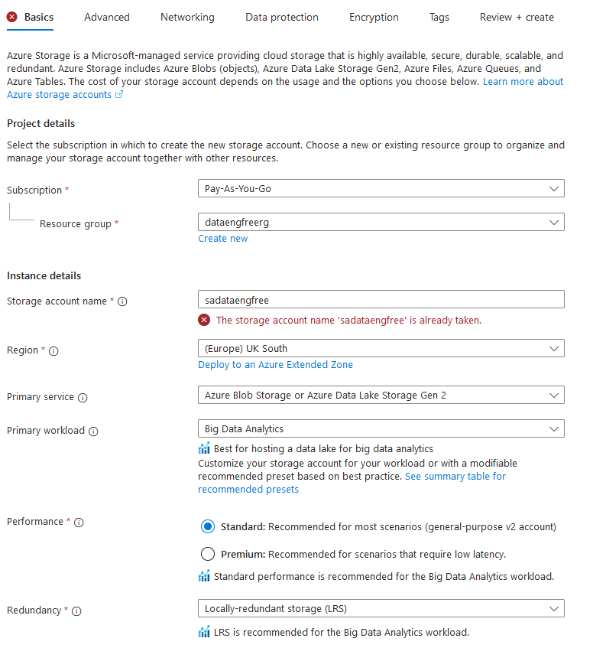
Create storage account

Slide 41
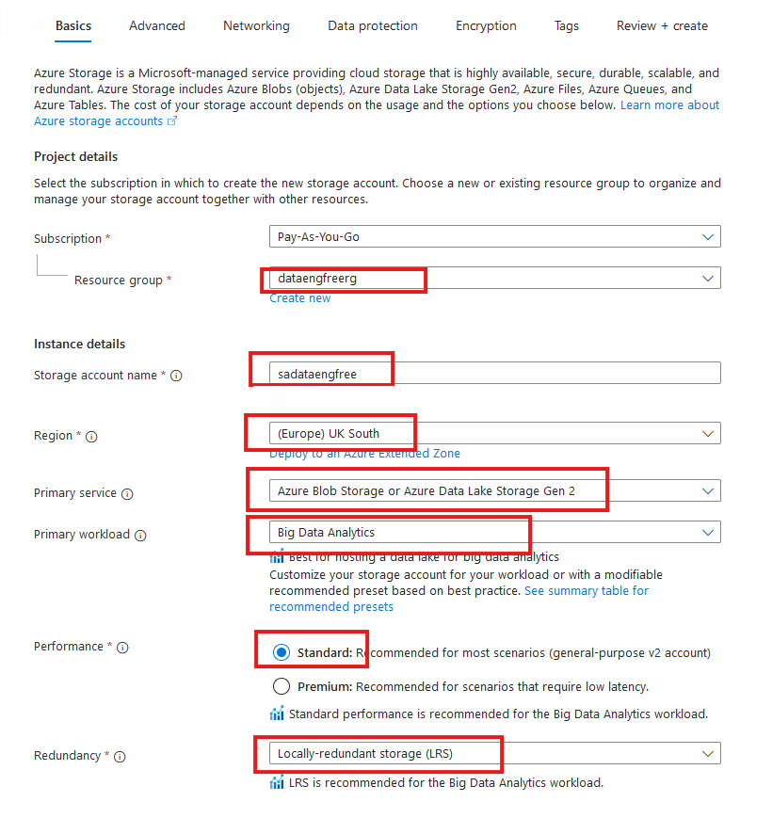
Create storage account

Slide 42
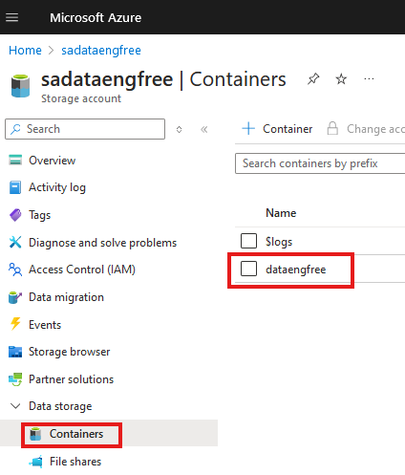
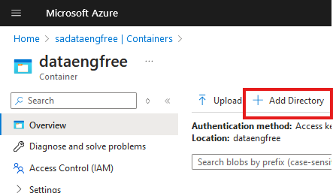

Slide 43
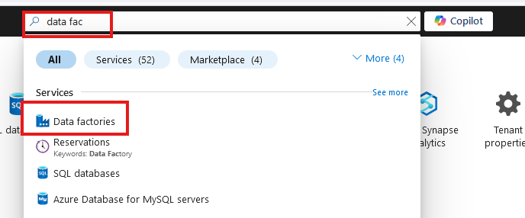
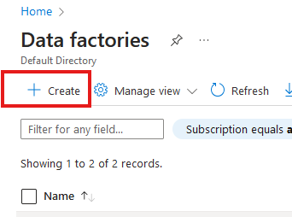
Create Azure Data Factory (ADF)

Slide 44
Create Azure Data Factory (ADF)

Slide 45
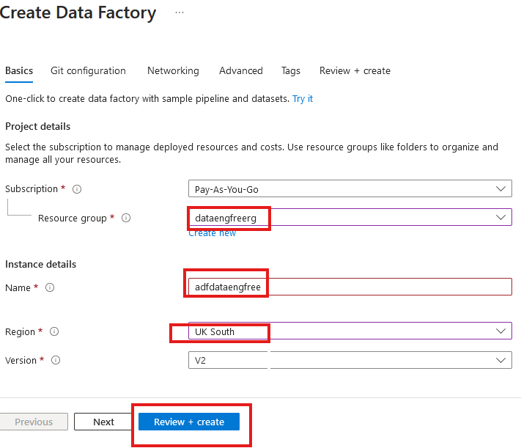
Create Azure Data Factory (ADF)

Slide 46
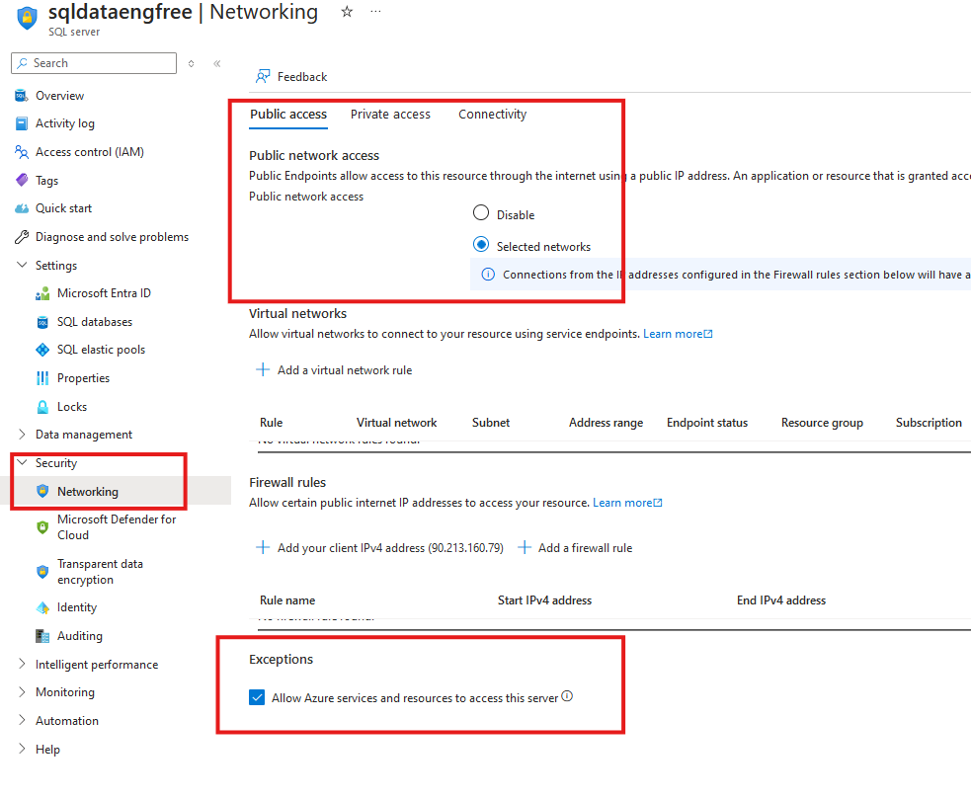

Slide 48


Slide 49


Slide 50
Python
Install Python
Set path
open Windows Terminal
- cd to user folder
- create folder & python file - hello-world.py
- open python file in notepad
- print('hello world')
- from terminal python hello-world.py
Run hello-world.py from VS Code in debug
Demo editing file and running in debug
Demo python from shell
Install Pip
Install Spark from Pip

Slide 51
PySpark

